Slide 1

PID requirements for EOSC
Sarah Jones, Jean-François Abramatic, Karel Luyben
with the help of others
Towards a European PID Service Amsterdam, 4-5 November, GEANT

Slide 2
Defining a PID policy for EOSC
Joint activity of Architecture and FAIR Working Groups
Two Task Forces (part of WG) established
Policy task force across WGs
Technical implementation task force within Architecture WG
Initial PID policy due late November at EOSC Symposium
Consultation planned in 2020 for final release in Q4

Slide 3
H2020 project inputs
Initiatives we are working with include FREYA, RDA GEDE, DONA Foundation, Datacite and Linked Data Platform
Reuse outputs from RDA Working Groups
Make use of PIDForum.org for consultation

Slide 4
PID Task Force literature review
Review existing PID policies
Collate key points from each
FAIR Principles and Extended FAIR Digital Object Requirements
GEDE PID Document
RDA Europe Conference on PIDs
PLOS Paper on URIs
IoT and Industrial Data Challenges
Turning FAIR into Reality report (FAIR Digital Object, FAIR Ecosystem)
ODIN, THOR, and FREYA projects
DONA Foundation
Derive
PID Policies
(to do)

Slide 5
Key issues
EOSC policy needs to be balanced (URIs, Handles, DOIs, etc.) and can’t preference one approach over another
We need to address all use cases – data, labs and publications
PIDs need to be globally unique, persistent and resolvable
Interoperability between PIDs
Scalability (trillions of PIDs due to FAIR F1)
PID system needs to be served by trusted registration authorities and service providers
Desire for lean, scalable and low-cost PID services
PID types need to be mature - have stable and trusted schemes with established PID service provider

Slide 6
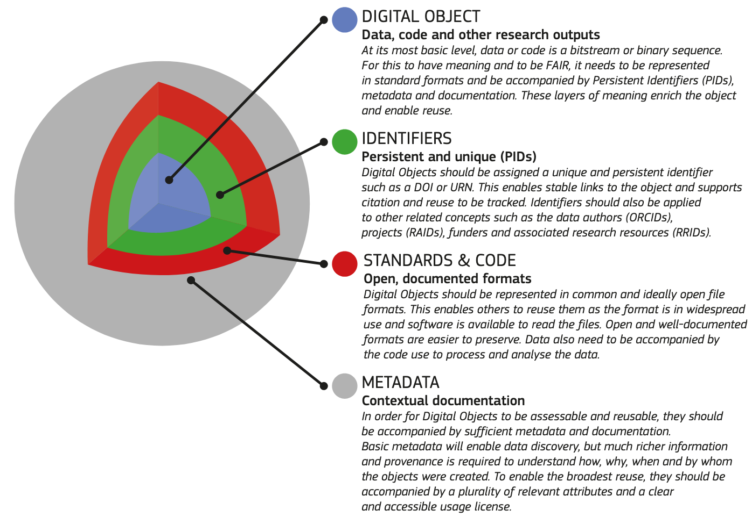
FAIR DO in Turning FAIR into Reality
Primary target:
FAIR Digital Objects
FAIR ecosystem
PIDs for DOs and all entities needed to make them FAIR e.g. people, organisations, software, services…
From Turning FAIR into reality, https://doi.org/10.2777/1524
Towards a European PID Service Amsterdam, 4-5 November, GEANT
Notes:
Covering both lab data and publications

Slide 7
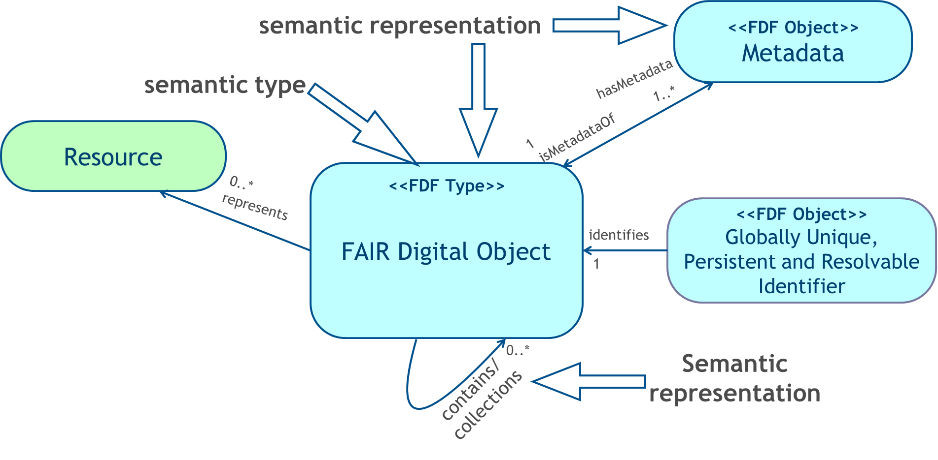
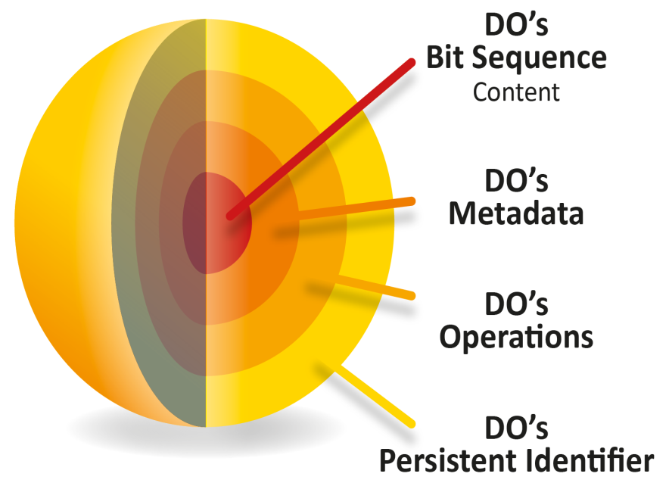
FAIR DO in GEDE & GOFAIR
Resolving PIDs is key (binding for basic FAIRness)
DO Content arbitrary (abstraction from details)
associating types with DOs (way towards automation)
all must be machine-actionable!
Towards a European PID Service Amsterdam, 4-5 November, GEANT
Notes:
Covering both lab data and publications

Slide 8
Build on existing infrastructure
Organizations Research Organization Registry https://ror.org/
Instruments RDA Persistent Identification of Instruments WG
Researchers e.g. ORCIDs
Datasets e.g. Handles, DOIs,
Emerging PID types
Established PID types
Support as core mature PID Schemes for at least publications, data, and people
Consider as additional candidate Core PID Resource Types: Organisations, Grants and Funding, Instruments and Equipment, and Software

Slide 9
PID Services
Core PID Services are:
PID Policy (RoP?) compliant
Enabler of FAIR Data
Part of federating core
Domain Specific PID Services
Shared or Added Value
PID Service | Description | User
PID creation | Creating new PIDs conformant to a PID Scheme, | Resource Creator/Owner
PID assignment | assignment of PIDs from a PID Scheme to a resource and the association of metadata on the resource | Resource Creator/Owner
PID resolution: | the direction to the associated resource from a PID under a PID Scheme, either directly or to a digital proxy. | Resource Seeker
PID description | the delivery of the metadata associated with a PID under a PID Scheme to allow the user to assess the associated resource | Resource Seeker
PID search | the PID collection should be searchable via its metadata to discover resources. | Resource Seeker
Added Value
Resource
Shared Resources
Federating and enabling services
Compliance

Slide 10
Conditions for Service Providers
A PID Service Provider (PSP) should have a sustainability plan
A PSP should be governed by a community relevant to EOSC
A PSP should make its requirements on repositories clear
A PSP should have procedures for change control and versioning
A PSP should have appropriate SLA for reliability
A PSP should have a guarantor for maintaining links if: resource disappears, or the PSP disappears

Slide 11
Feedback from EOSC@RDA event
Strong requirement for machine-actionability
Need for tombstones for when content removed
Granularity & versioning e.g. longitudinal datasets
Different requirements of PIDs across different stages in the research lifecycle
Policy needs to be high level but be accompanied with technical implementation guidance

Slide 12
Upcoming Work
Discuss input from RDA break-out sessions and the implications at policy level
Identify and include work from RDA supporting FAIR Digital Objects (PID Kernel, Type Registry, etc.)
Discuss scope and abstraction level (FREYA input)
Edit and present Draft Policy v. 0.1 for community discussion
Discuss services based on FAIR DO requirements
Notes:
The combined Architecture and FAIR WG task force will be meeting for the first time next week.
Even if FAIR Digital Objects form the foundation, input from the community, from FREYA and other projects will be included.
This is a rough outline of the work for the coming months.

Slide 13

Consult on the draft PID policy at the
EOSC Symposium
Image You X Ventures https://unsplash.com/photos/Oalh2MojUuk

Slide 14

Join us at PIDapalooza

Slide 15

Thanks for listening!
Questions?

